Slide 1
Origami Desk Nameplate

Slide 2
Take a piece of A4 paper.

Slide 3
Fold it
like this inwards.

Slide 4
Fold it in half and open it up again.

Slide 5
Now fold the top down. Then open up.

Slide 6
Do the same with the bottom.

Slide 7
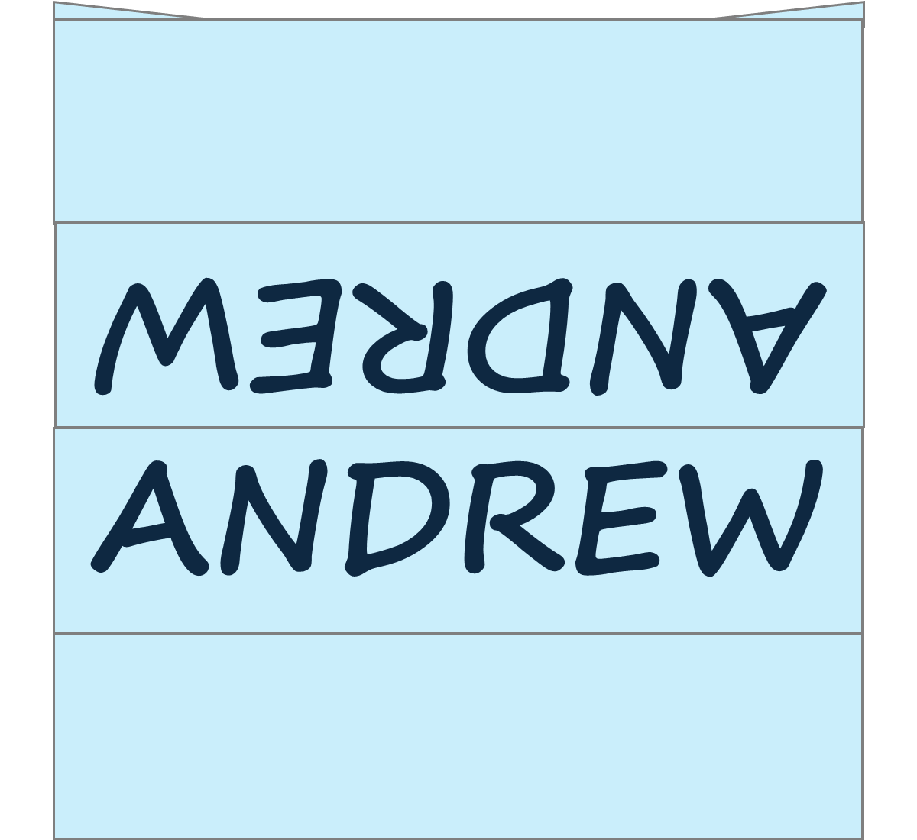
Turn over and write your name like this

Slide 8
ANDREW
Now tuck the one end into the other and place it on the table so that we know who you are.

